Slide 1
Java 9
New Features

Slide 2
Features
1. Java 9 REPL (JShell)
2. Factory Methods for Immutable List, Set, Map and Map.Entry
3. Private methods in Interfaces
4. Java 9 Module System
5. Process API Improvements
6. Try With Resources Improvement
7. CompletableFuture API Improvements
8. Reactive Streams
9. Diamond Operator for Anonymous Inner Class
10. Optional Class Improvements
11. Stream API Improvements
12. Enhanced @Deprecated annotation
13. HTTP 2 Client
14. Multi-Resolution Image API
15. Miscellaneous Java 9 Features

Slide 3
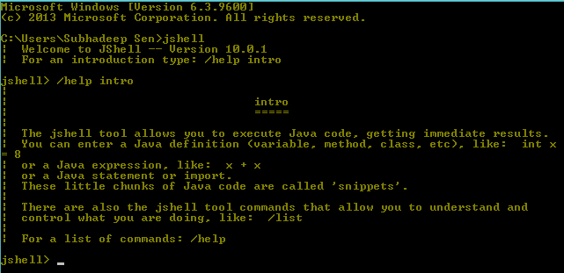
JShell
Stands as Java Shell and also known as REPL (Read, Evaluate, Print, Loop)
A new tool to test and execute piece of java code.
Execute class, interface, enum, object, statements etc. very easily

Slide 4
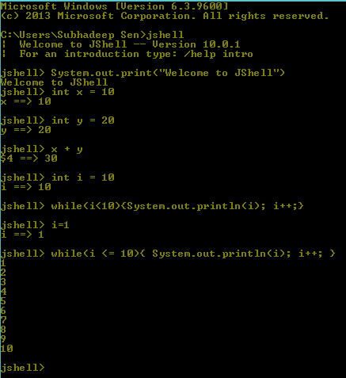
JShell

Slide 5
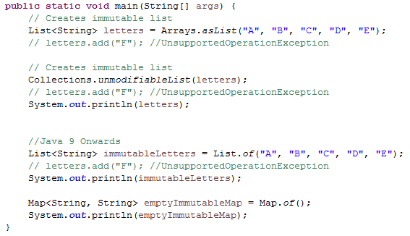
Factory Methods
To create Immutable List, Set, Map and Map.Entry objects. These utility methods are used to create empty or non-empty Collection objects.
List and Set interfaces have “of()” methods to create an empty or no-empty Immutable List or Set objects.

Slide 6
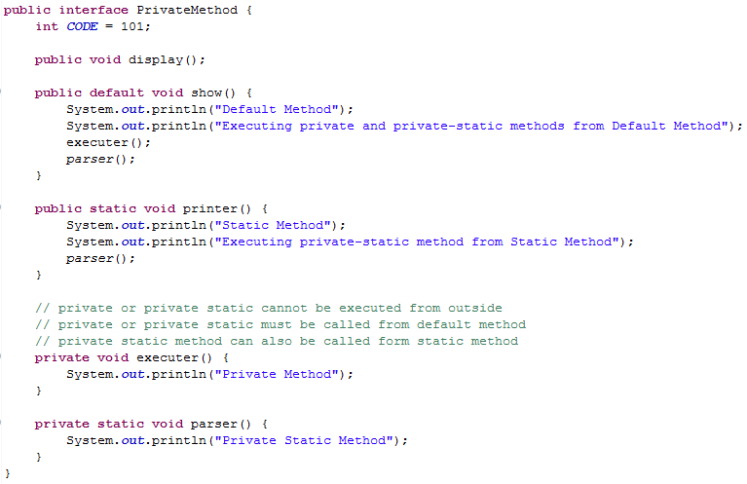
Private Methods in Interface
Constant variables
Abstract methods
Default methods
Static methods
Private methods
Private Static methods

Slide 7
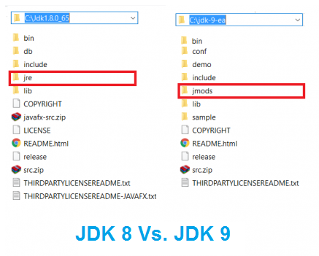
Java 9 Module System
Before Java SE 9 versions, we are using Monolithic Jars to develop Java-Based applications.
This architecture has lot of limitations and drawbacks. To avoid all these shortcomings, Oracle Corp. has introduced Module System Java SE 9.
JDK 9 has 92 modules.
We can also create our own modules.
The directory structure of the JDK has changed a bit.
A directory, jmods, is added. This directory contains a
jmod file for each module. A jmod file is like a JAR
file, but for modules. You can unzip the file and look
at the contents. It contains the compiled classes for
this module.

Slide 8
Java 9 Module System
What is a Module?
A Module is a group of closely related packages and resources along with a new module descriptor file. In other words, it’s a “package of Java Packages” abstraction that allows us to make our code even more reusable.
Every module contains ---
Name → Name of the module
Dependencies → Other dependent modules
Public Packages → Packages accessible from outside
Services Offered → Service implementation to be consumed by other modules
Services Consumed → Consumed services
Reflection Permissions → explicitly allows other classes to use reflection to access the private members of a package
The file which stores all the above information (description about the module) is know as Module Descriptor or module-info.java.

Slide 9
Java 9 Module System
Types of Modules:
System Modules : It Includes the Java SE and JDK modules. These modules are listed when we run the list-modules command.
Application Modules : Modules developed for application are named and defined in the compiled module-info.class file.
Automatic Modules : We can include unofficial modules by adding existing JAR files to the module path. The name of the module will be derived from the name of the JAR. Automatic modules will have full read access to every other module loaded by the path.
Unnamed Module : When a class or JAR is loaded onto the classpath, but not the module path, it’s automatically added to the unnamed module. It’s a catch-all module to maintain backward compatibility with previously-written Java code.

Slide 10
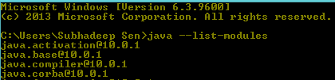
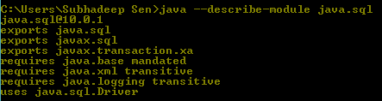
Java 9 Module System
Command to see the available modules:
java --list-modules
Each module ends with @jdk_version
Module properties are located in a module-info.java file. To see the info execute the following command in command line.
java --describe-module module_name
java --describe-module java.sql

Slide 11
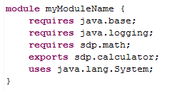
Java 9 Module System
Create your own Module:
To create a module, we need to add a special file at the root of our packages and that file is know as module-info.java or Module Descriptor.

Slide 12
Java 9 Module System
Directives used in Module Definition:
Requires
Requires Static
Requires Transitive
Exports
Exports - To
Uses
Provides - With
Open
Opens
Opens - To

Slide 13
Java 9 Module System
Example:
We’ll create two java projects, named as Math-Module and Calculator-Module.
Math-Module will contain a class MathModule.java inside src/sdp.math package with add, sub, mul and div function and module-info.java inside src and we are going expose this module.
In Calculator-Module, we are going consume Math-Module.
Every custom module needs to be added in module-path. So, don’t forget to add the Math-Module in module-path in build configuration.

Slide 14
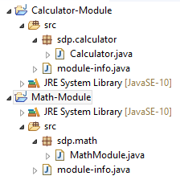
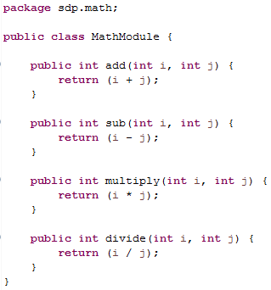
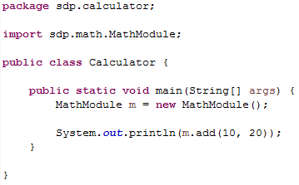


Java 9 Module System

Slide 15
Process API Improvements
Improved Process API helps to control and manage the process of operating systems.
ProcessHandle Class and nested interface Info provide process's native process ID, start time, accumulated CPU time, arguments, command, user, parent process, and descendants.
Process Class Methods:
Stream<ProcessHandle> children()
Stream<ProcessHandle> descendants()
long getPid()
ProcessHandle.Info info()
CompletableFuture<Process> onExit()
boolean supportsNormalTermination()
ProcessHandle toHandle()
ProcessHandle Class Methods:
static Stream<ProcessHandle> allProcesses()
Stream<ProcessHandle> children()
int compareTo(ProcessHandle other)
static ProcessHandle current()
Stream<ProcessHandle> descendants()
boolean destroy()
boolean destroyForcibly()
long getPid()
ProcessHandle.Info info()
boolean isAlive()
static Optional<ProcessHandle> of(long pid)
CompletableFuture<ProcessHandle> onExit()
Optional<ProcessHandle> parent()
boolean supportsNormalTermination()
ProcessHandle.Info Methods:
Optional<String[]> arguments()
Optional<String> command()
Optional<String> commandLine()
Optional<Instant> startInstant()
Optional<Duration> totalCpuDuration()
Optional<String> user()

Slide 16
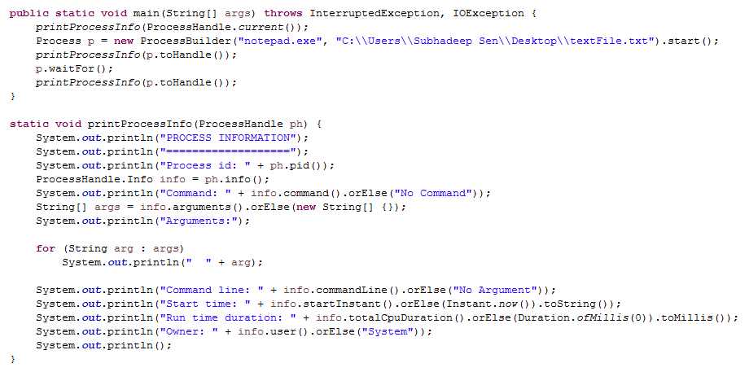
Process API Improvements

Slide 17
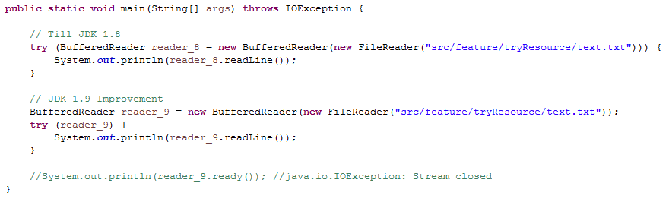
Try with Resource Improvements

Slide 18
CompletableFuture API
Perform possible asynchronous (non-blocking) computation and trigger dependent computations which can also be asynchronous.

Slide 19
CompletableFuture API
CompletableFuture class was introduced in Java 8 to represent the Future which can be completed by setting its value and status explicitly.
It supports dependent functions and actions which got triggered upon the future's completion. In java 9 CompletableFuture API has been enhanced further.
Support for delays and timeouts.
Improved support for sub-classing.
New factory methods added.
*** NEED TO DIG MORE

Slide 20
Reactive Streams
sdfsdf
*** NEED TO DIG MORE

Slide 21

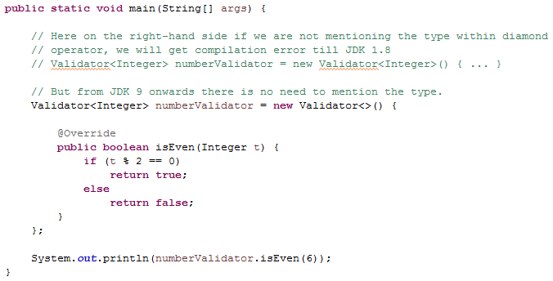
Diamond Operator for Inner Class
Till JDK 1.8, we were bound to mention the type on the right-hand side within diamond operator while creating object of anonymous inner class of a generic type.
But JDK 1.9 onwards there is no need to mention the type.

Slide 22
Optional Class Improvements
The following 3 methods are introduced.
stream()
ifPresentOrElse()
or()

Slide 23
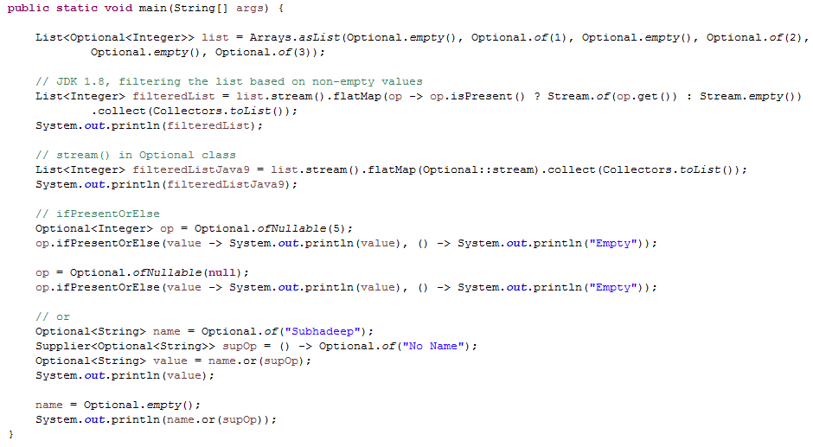
Optional Class Improvements

Slide 24
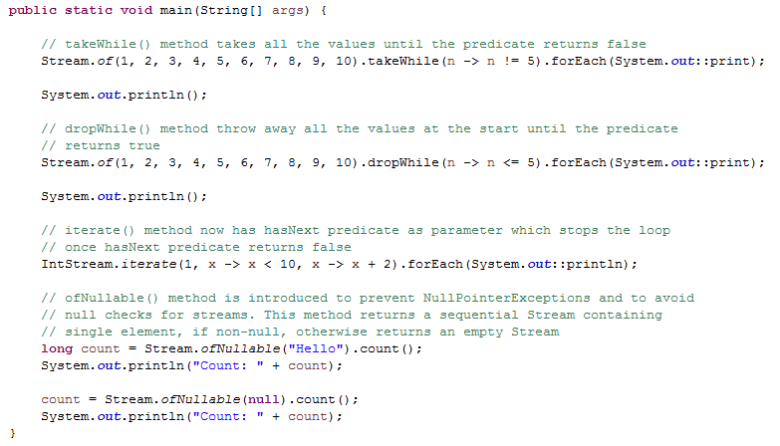
Stream API Improvements
The following 4 methods are introduced.
takeWhile
dropWhile
iterate
ofNullable

Slide 25
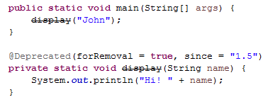
Enhanced @Deprecated Annotation
@Deprecated means:
Usage may lead to errors.
May be incompatible in future version.
May be removed in future version.
A better and efficient alternative has super-seeded it.
Compiler generates warnings whenever a deprecated element is used. With Java 9, two new enhancements are made to @Deprecated annotation.
forRemoval − Indicates whether the annotated element is subject to removal in a future version. The default value is false.
since − Returns the version in which the annotated element became deprecated. The default value is the empty string.

Slide 26
HTTP2 Client
sdfsdf

Slide 27
Multi-Resolution Image API
sdfsdf

Slide 28
Miscellaneous Java 9 Features
Apart from mentioned features, with Java 9, a lot more enhancements are done to JDK platform. Some of them are listed below.
GC (Garbage Collector) Improvements
Stack-Walking API
Filter Incoming Serialization Data
Deprecate the Applet API
Indify String Concatenation
Enhanced Method Handles
Java Platform Logging API and Service
Compact Strings
Parser API for Nashorn

Slide 29
References
https://www.tutorialspoint.com/java9/
https://dzone.com/articles/java-9-modules-introduction-part-1
https://www.baeldung.com/java-9

Slide 30
Thank You

